Slide 1
Gordon College Uniform Reservation Group: Code Us

Slide 2
Background of the project
This Gordon College Uniform Reservation Website is created to reserve uniforms in Gordon College only for GC students. This reservation site will minimize the time of students because even if you are anywhere you can reserve and get the uniform when it release instead of going to school and falling in long line for reservation. Only students of Gordon College can access and login in Gordon College Uniform Reservation. The login system use student id and given password that can be change later by the student when they logged in.

Slide 3
Flowchart
Login page
Yes
login
user logout?
No
Login successfully ?
No
Display alert message
Uniform page
Uniform page
Message:
Reserve Successfully!
reserve
Inserting into database.
uniform_reservation table
Yes
Reserve success?
No
Message:
Failed! Try again

Slide 4
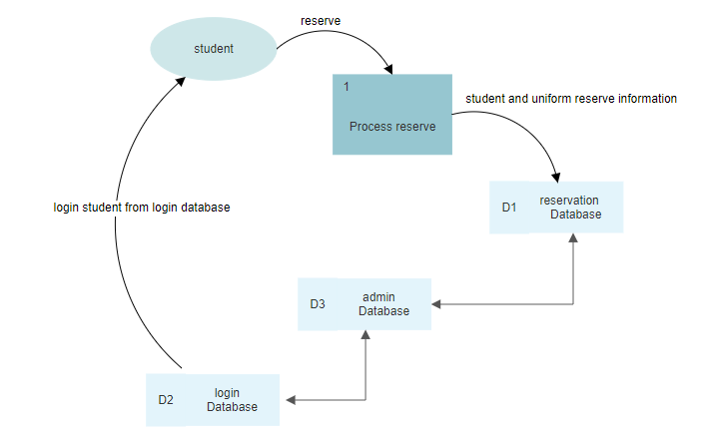
Data Flow Diagram (DFD)

Slide 5
ERD
reservation
reserveNo
studentID
Course
Fullname
uniform_type
uniform_size
uniform_qty
admin
adminID
username
password
login
ID
studentID
Department
Course
Year
Fullname
password

Slide 6
Division Of Labor
Arshley L. Tan (Back-end web developer)
- Created the databases and tables.
- Programmed functions & process of reservation. (PHP, MySQL & HTML)
- Documentation.
Beverly Karen Bernardino (Front-end web developer)
- Created the whole website and system design which is the User Interface (UI) and User Experience (UX).
Including the login page of the user (student) and login page of the admin. (HTML, CSS)
- Documentation.
- Collect & made 100+ for user login data.
Fatrizha Alejah Boongaling (Tester)
- Test the whole website if there is a bug and error. Test all the functionalities and the connection of the website into the database system, and check the codes of the whole website and also the back-end system and database and the one who fixed bugs.
- Collect & made 100+ for user login data.
- Documentation.

Slide 7
Conflict Encounter
The conflicts we encounter are:
Connecting php into database but its solved now.
XAMPP error. It’s an application error where our programmer XAMPP application is no connecting to the server because MySQL is unexpectedly shutdown.
Process of locating and viewing user’s data in account page. But its solved now.
The pop-up modal made me cry hard to create but I’ve done it. This modal is for reservation.
Reservation button process when modals come up with the uniform name, size, and quantity it’s really hard to make it and to debug because it has a lot of errors.
Positioning of the uniforms in uniform page.
Login page process. This is the first and for me most difficult part. There is a bug on this were when the user login and prompt the homepage and then the user logout and when she/he press the back button of the browser his/her account will login again without signing in in this case user privacy may view by others instantly when you click browser back button even if the user press logout. I’m glad that this bug is fixed almost 5 days.
Time management.

Slide 8
Conflict Encounter
Lack of group discussion and interaction because its hard to make a plan or a project when the only way to communicate to your members is internet and no physical interaction or discussion due to covid-19 and there is no face to face.
Website design and effects especially the color scheme and the fonts. Picking color scheme and fonts is also difficult because the font and colors should match according to the website is about. So, we decided that the color we use is lightly green/green and put two different font- styles.

Slide 9
THANK YOU !

